Slide 1
Project Presentation On “Car Price Prediction” Presented By: Ajit Madame

Slide 2
Agenda
Problem Statement
Problem Understanding
Exploratory Data Analysis
Data Preprocessing Steps
Model Building
Interpretation of the Results
Hyperparameter Tuning
The Model Saving And Testing
Key Finding and Conclusions
Limitation of this works and Scope for Future Works

Slide 3
Problem Statements
With the covid 19 impact in the market, we have seen lot of changes in the car market. Now some cars are in demand hence making them costly and some are not in demand hence cheaper. With the change in market due to covid 19 impact. For this I am collecting data from cars24.com and make data frame and used this data for building the model.
The project Car Price Prediction deals with providing the solution to this problem. Through this project, we will get to know which of the factors are significant and tell us how they affected the cars market.

Slide 4
Problem Understanding
A good knowledge of after sales market of cars is necessary. What makes a car valuable will be key. As the mobile internet improves by leaps and bounds, the model traditional offline used car trading has gradually lost the ability to lives up to the needs of customers, and online used car trading platforms have emerged as the times require. Second-hand car price prediction is the premise of second-hand car trading, and reasonable price can reflect the objective, fair and true nature of the second-hand car market.

Slide 5
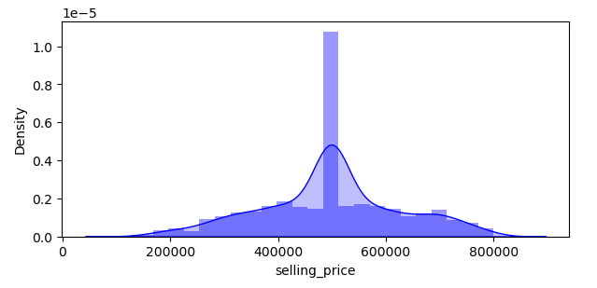
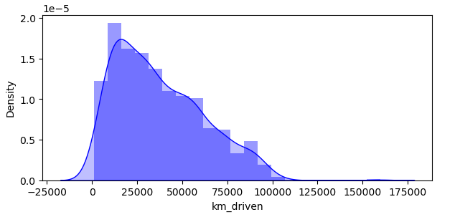
Exploratory Data Analysis
Univariate Analysis
Observation
# We can see selling price is look like that data has normally distributed. We can see, maximum selling price lies in the range of 4 to 6 Lakh.
# We can see, km driven has not a normally distributed but maximum data lies in the range of 0 to 100000 km.

Slide 6
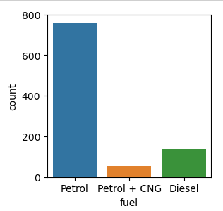
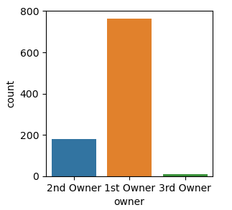
Observation: # We can see, Fuel as petrol has maximum count followed by Diesel. Petrol + CNG has lowest count than others. It means that maximum people are used petrol vehicle than others. But petrol vehicles are more expensive than others. # We can see, 1st Owner owned vehicle are highest for selling followed by 2nd Owner. It simple because 1st owner vehicles are having more selling than others.

Slide 7
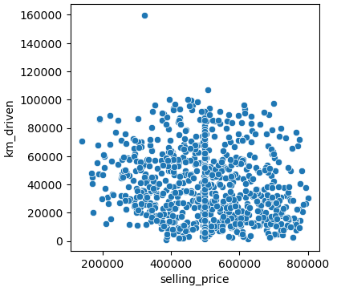
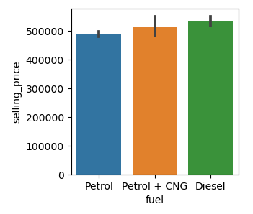
Bivariate Analysis Observation: # We can see, there are no direct relationship of both feature to each other’s. But the vehicle km driven are in 0 to 80000km those are having good price. And we can see maximum vehicle km driven lies in this range. # We can see, Diesel vehicles are having maximum selling price than others. Whereas petrol vehicles are having lowest selling price than others. But all are having very little difference in their selling price.

Slide 8
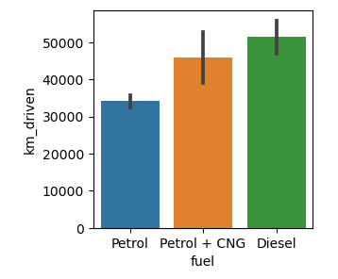
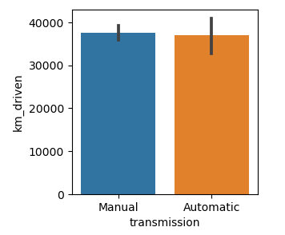
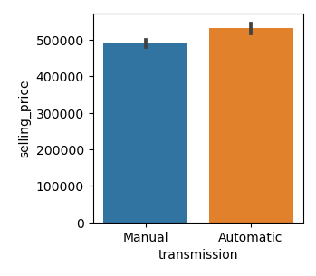
Observation: # We can see, Diesel cars are having maximum km_driven. It means that, diesel cars running km is high they used more. Petrol cars are having lowest km_driven. But here is little contrast that, generally those cars driven less km they are having high price but here is opposite. # We can see, manual and automatic both type of transmission is having almost same km_driven. But Automatic transmission little lower than Manual transmission cars. # We can see, Automatic transmission cars are having higher selling price than Manual transmission cars. But there is no major difference in selling price of both transmission cars. We can see, up to the range 0 to 450000 both are having same price.

Slide 9
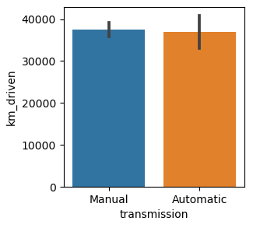
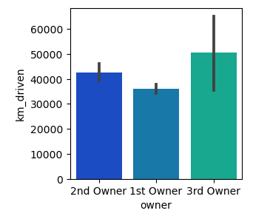
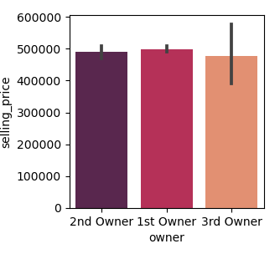
Observation: # We can see, both transmissions are having almost same km driven. # We can see, 3rd owner cars are having maximum km_driven. It obviously because these are cars owned by multiple owners and they drive these cars more. 1st owner cars are having less km driven. # We can see, 1st owner cars are having maximum selling price than others. But all are having almost same range of selling price.

Slide 10
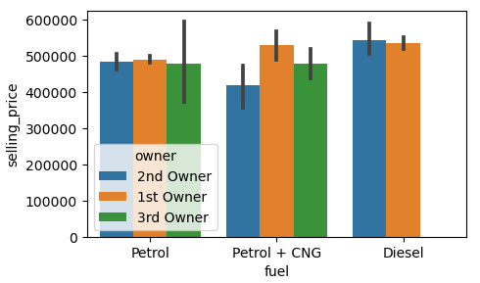
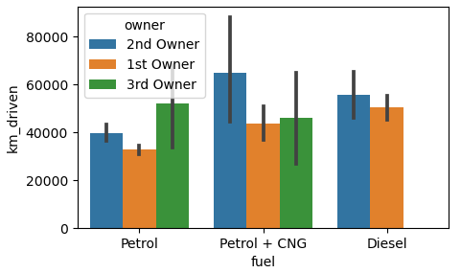
Multivariate Analysis Observation: # We can see, in all variants of fuel, 1st owner are having maximum cars selling price than others owner. But in Petrol fuel variant, all owners are having almost same selling price there is no major difference in selling price. # 2nd owner is top in petrol + CNG and diesel variants of car. It means in these two variants of fuel in which 2nd owner are drive a cars maximum km than others. But in Petrol fuel cars, in which 3rd owner cars are having maximum km driven.

Slide 11
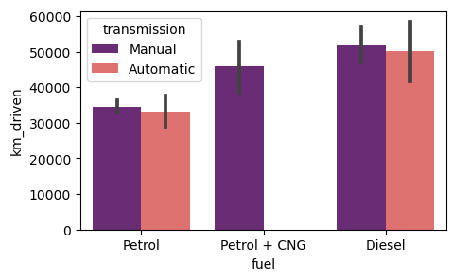
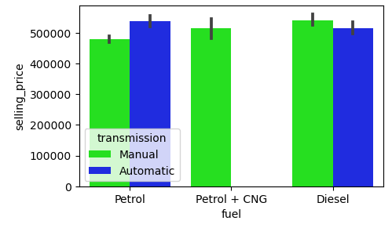
Observation: # We can see, in all fuel type, Manual transmission cars are having maximum km_driven. But in Petrol+CNG variants cars, there is Automatic transmission cars. # We can see, In Petrol fuel type, In which automatic transmission cars are having maximum selling price than others. But petrol+CNG fuel type, there is no automatic transmission cars.

Slide 12
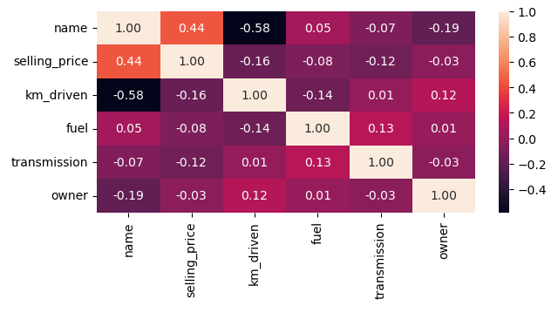
Correlation of the features with target columns Observation #name has 44% positive correlation with target column. # km_driven has 16% negative correlation with target column. # fuel has 8% negative correlation with target column. # transmission has 12% negative correlation with target column. # owner has 3% negative correlation with target columns.

Slide 13
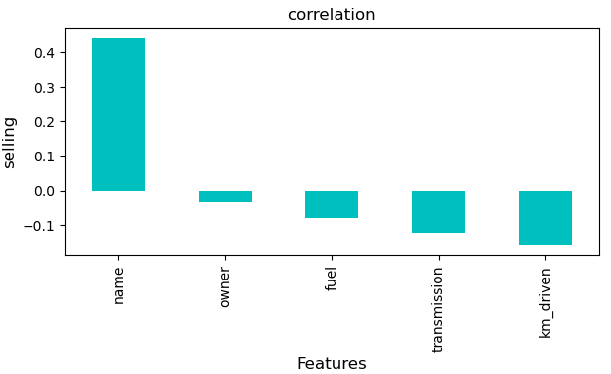
Visualizing correlation of feature columns with label column. Observation: # Name have the strongest positive correlation with Selling Price. # While km_dricven, transmission, fuel have the strongest negative correlation with Selling Price.

Slide 14
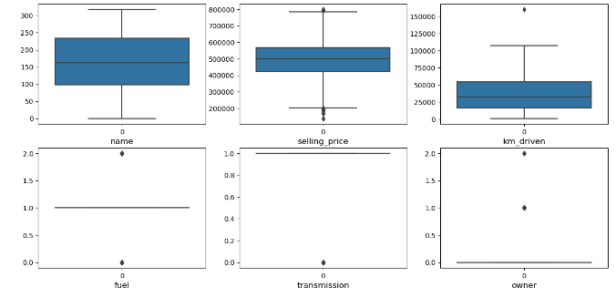
Checking Outliers Observation: We can see, selling price and km_driven are having some outliers.

Slide 15
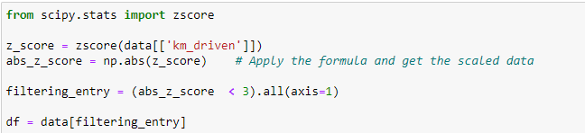

Removing Outliers Percentage of data Loss

Slide 16
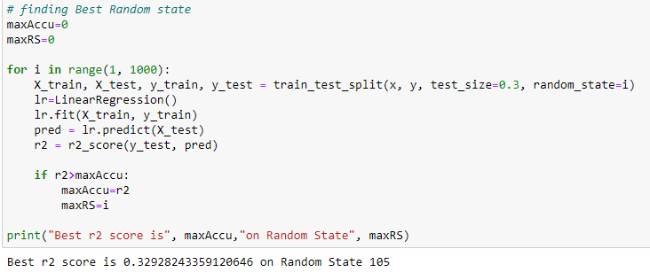
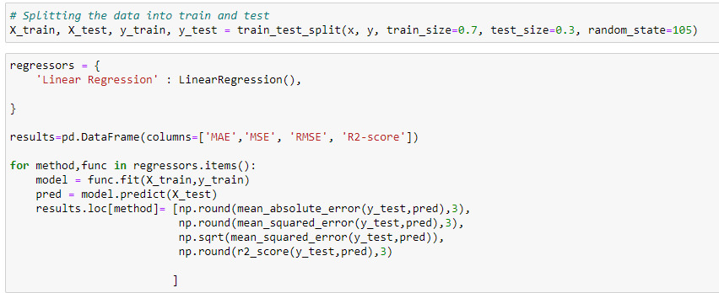
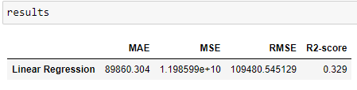
Model Building Linear Regression: Finding Best Random State Train and Test

Slide 17
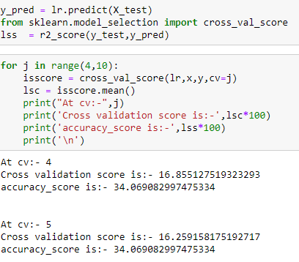
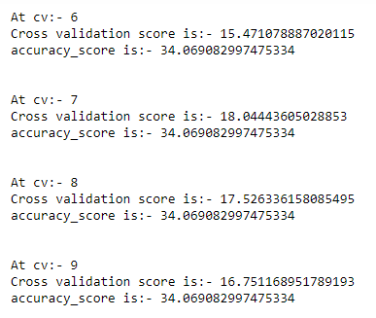
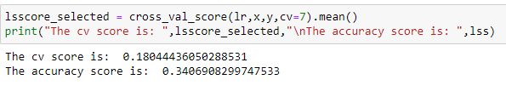
Cross Validation of the Model

Slide 18
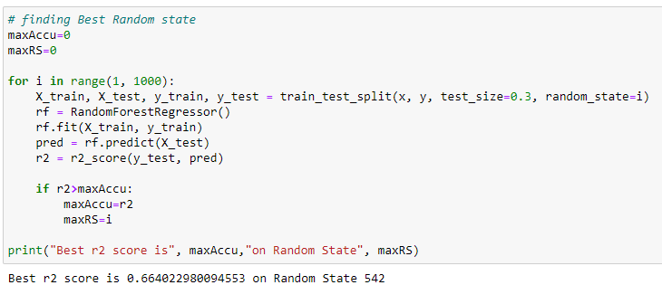
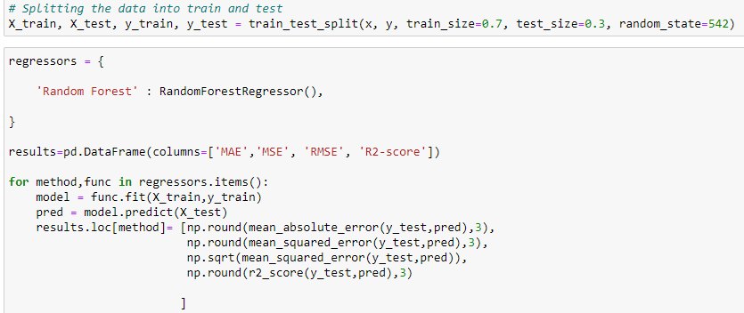
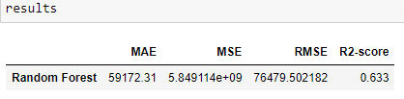
Random Forest Regressor Finding Best Random State Train and Test

Slide 19
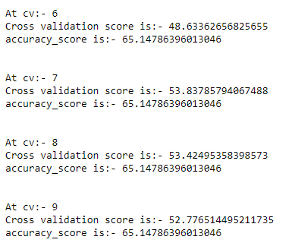
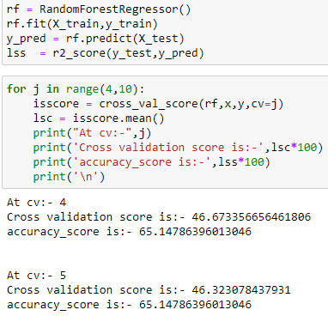

Cross Validation of the Model

Slide 20
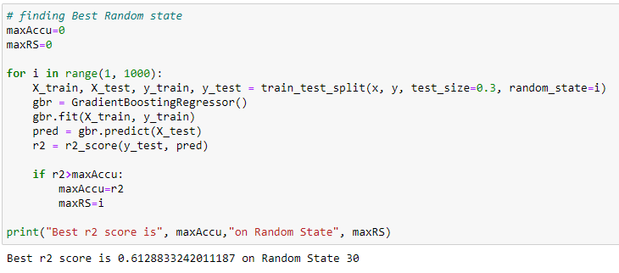
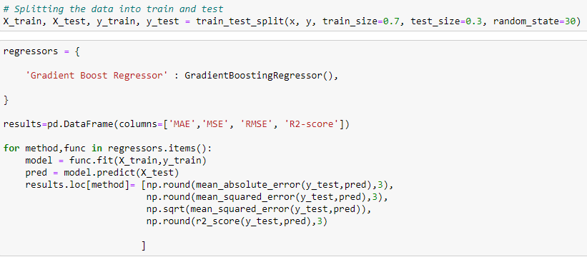
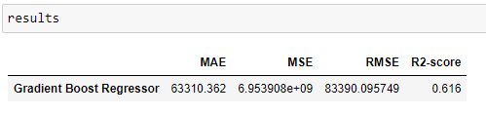
Gradient Boost Regressor Finding The Best random State Train and Test

Slide 21
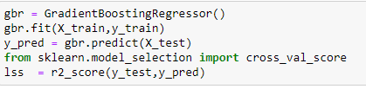
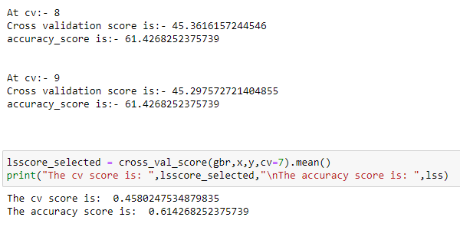
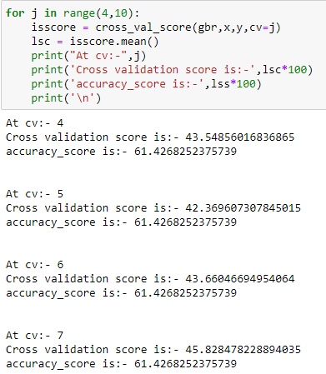
Cross Validation of the Model

Slide 22
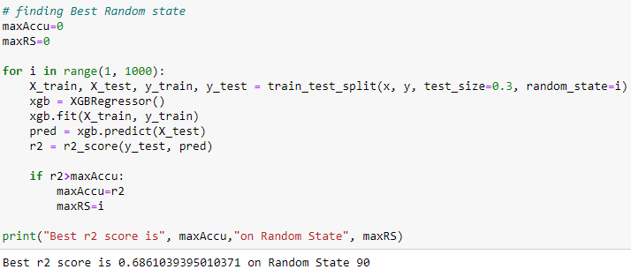
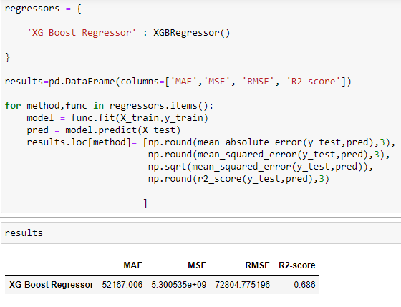
XGBRegressor Finding Best Random State Train and Test

Slide 23
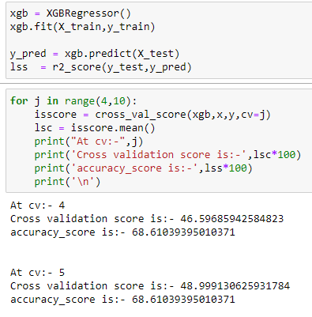
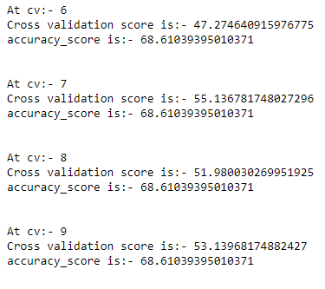
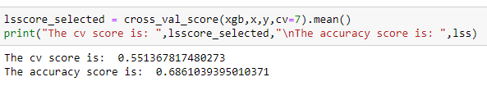
Cross Validation of the Model

Slide 24
Interpretation of the Result Based on comparing Accuracy Score results with Cross Validation results, it is determined XGboost Regressor is the best model. It has least difference between accuracy score and cross validation score.

Slide 25
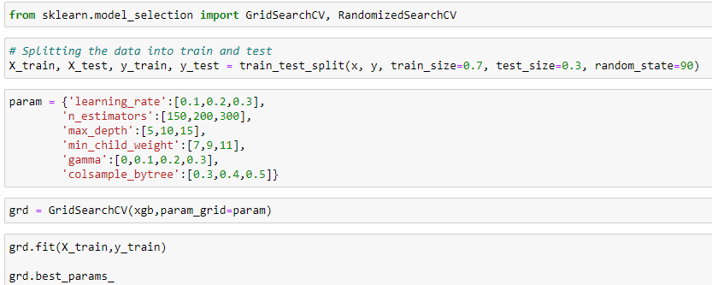
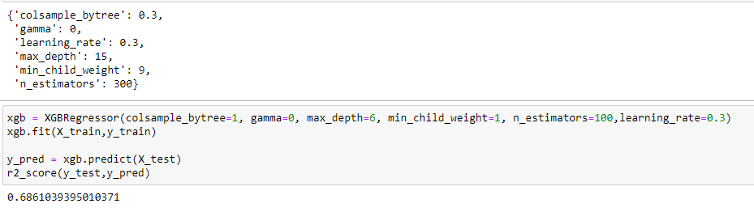
Hyperparameter Tuning Based on the input parameter values and after fitting the train datasets The XGBoost Regressor model was further tuned based on the parameter values yielded from GridSearchCV. The XGBoost Regressor model displayed an accuracy of 68.62%.

Slide 26
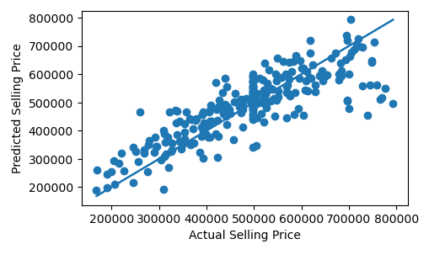
Scatter plot Between Actual and Predicted Selling Price of Car

Slide 27
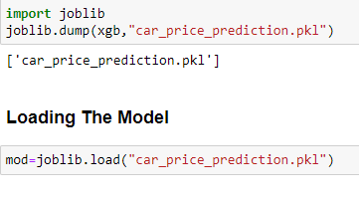
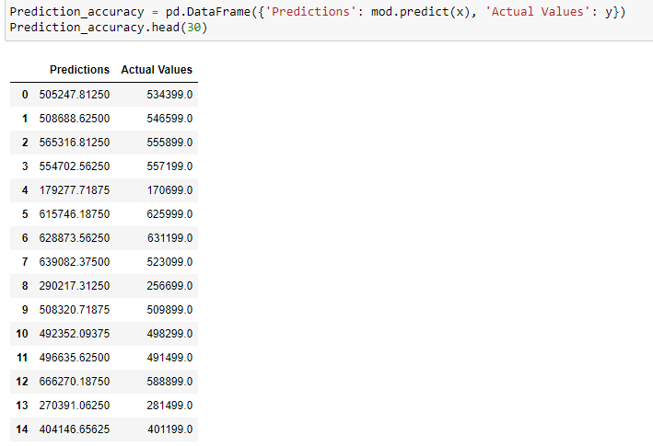
The Model Saving and Testing

Slide 28
Key Finding and Conclusions The main component on which the price of a car depends is the engine size, the year which car was bought, the mileage on the car etc. The price also depends on which city the car was registered, as some cities have different tax rates and restrictions. XGBRegressor works best for this particular data set, hyper parameter tuning was performed, and optimal parameters were found. EDA is very powerful in understanding the data and pre-processing it before feeding it to the algorithm. Statistical methods work the best.

Slide 29
Limitation of this work and scope for future Post covid-19 car market is still evolving, and it will keep evolving for the foreseeable future. The algorithms will need to keep changing to keep up with the evolution.

Slide 30


